Slide 1

IGAT
Internet Gaming Analysis & Trends
FYP Team
Ahmad Waseem 128209
Muneeb Zia 128241
Kainat Shaikh 128155
Supervised by
Ms. Asma Sattar

Slide 2
Outline
Problem Statement
IGAT Description
Use Case Diagram
Web Crawling
Web Scraping
Data Parsing
Class Diagram
Demo

Slide 3
Problem Statement
User have less information about its features.
User have no time.
Games according to user’s interest.

Slide 4
IGAT Description
User reviews based rating
Game specification with categories.
Top recommendations for users.
Web Based Portal
Categories
Sub Categories

Slide 5
Use Case Diagram
[7]

Slide 6
Web Crawling
Focused Crawling
Regex

Slide 7
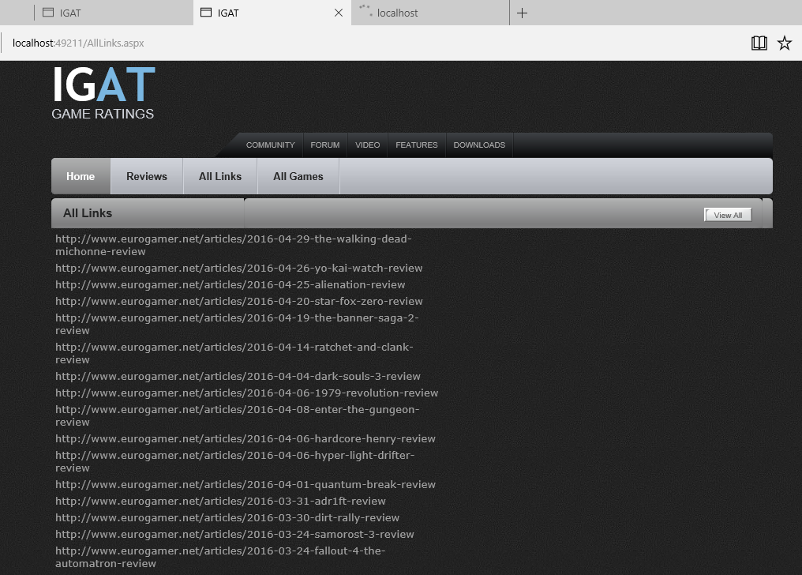

Slide 8
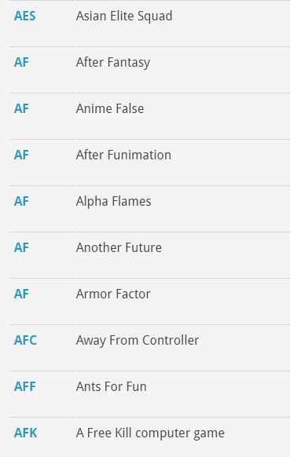
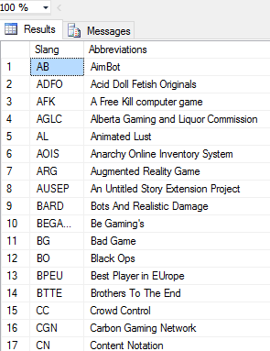

Slide 9
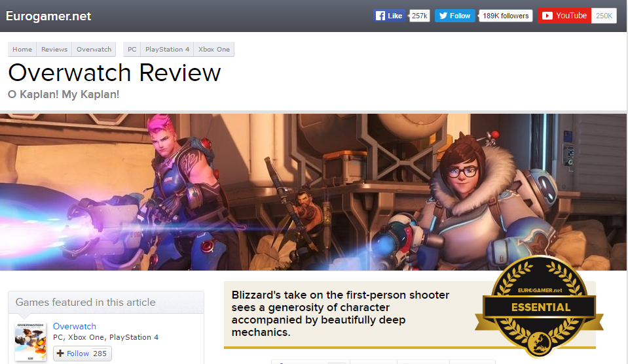
Web Scraping
Saving Games
Getting Game Ids for Comments

Slide 10
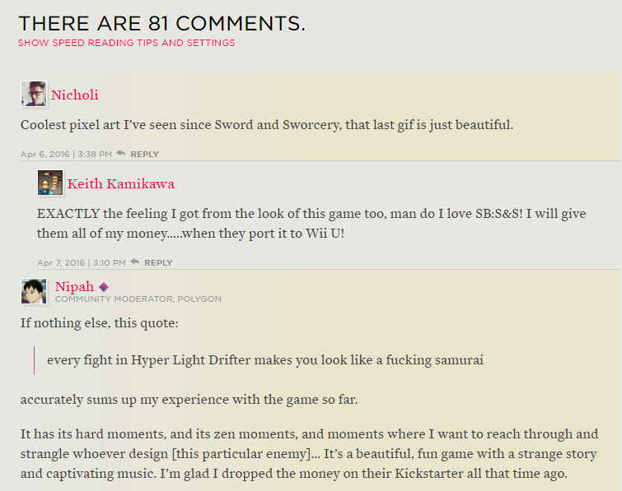
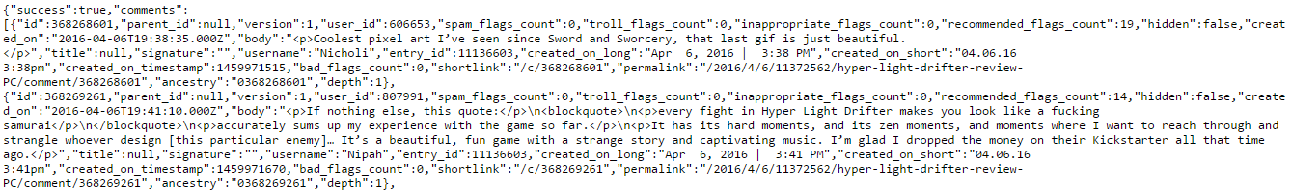
Web Scraping
Getting Comments in JSON

Slide 11
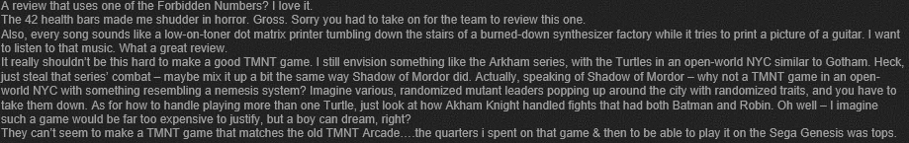
Data Parsing
Parsing from JSON to Text

Slide 12
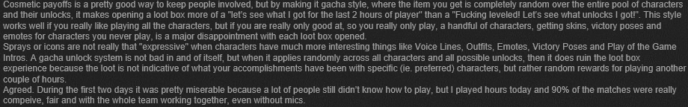
Data Parsing
Internet Slang Words Filter
Gaming Slang Words Filter
Abusive Words Filter

Slide 13
Class Diagram

Slide 14
Demo

